Slide 1
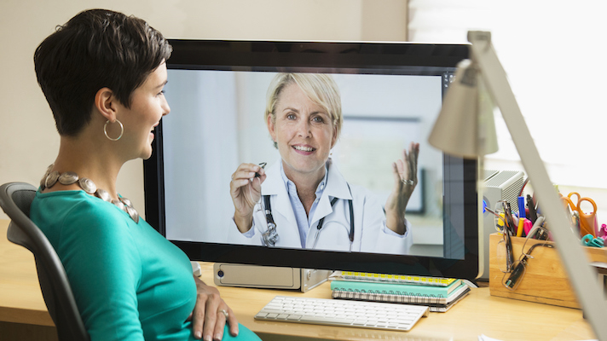
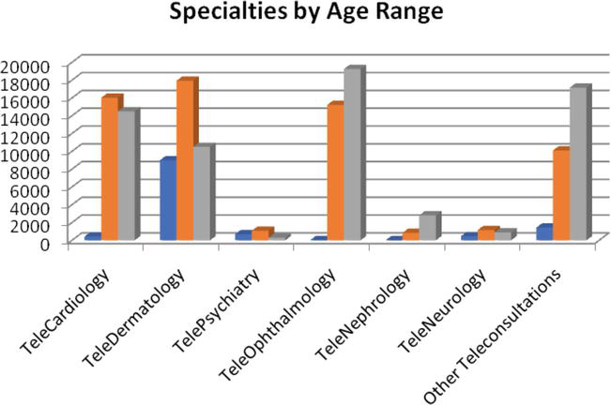
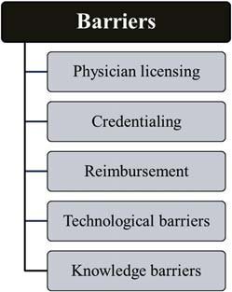
Real-time Telemedicine
Real-time telemedicine is a type of telemedicine that makes it easy for the doctor-patient visit anytime, anywhere. Through real-time telemedicine, a doctor is able to offer a live consultancy services to the patients. Real-time telemedicine allows two-way communication through phone consultation and video conferencing, which allows the provider and patients to have a communication in real time.
Benefits of telemedicine in real-time telemedicine
It helps in overcoming the geographical barrier between the patients and the doctors.
It improves the quality of healthcare provided, especially for the patients with both mental and physical health problems.
It helps in facilitating the traditional face to face medicine
Improves the provider satisfaction
It helps in improving provider satisfaction.
Disadvantages
It has unrestricted use which can lead to abuse of the system, because even the unqualified and untrained personel can offer unsolicited opinion.
It can lead to poor patient-doctor relationships.
It requires expensive equipment.
The information is prone to theft.
References
Anton, D., Kurillo, G., Yang, A. Y., & Bajcsy, R. (2017, January). Augmented telemedicine platform for real-time medical consultation. https://link.springer.com/chapter/10.1007/978-3-319-51811-4_7
Neoplasm, D. C. (2017). Real-time patient–provider video telemedicine integrated with clinical care. Ann Fam Med, 15, 225-9. https://www.sciencedirect.com/science/article/pii/S1537511015000598
Tan, I. J., Dobson, L. P., Bartnik, S., Muir, J., & Turner, A. W. (2017). Real-time teleophthalmology versus face-to-face consultation: https://journals.sagepub.com/doi/abs/10.1177/1357633X16660640

